Slide 1
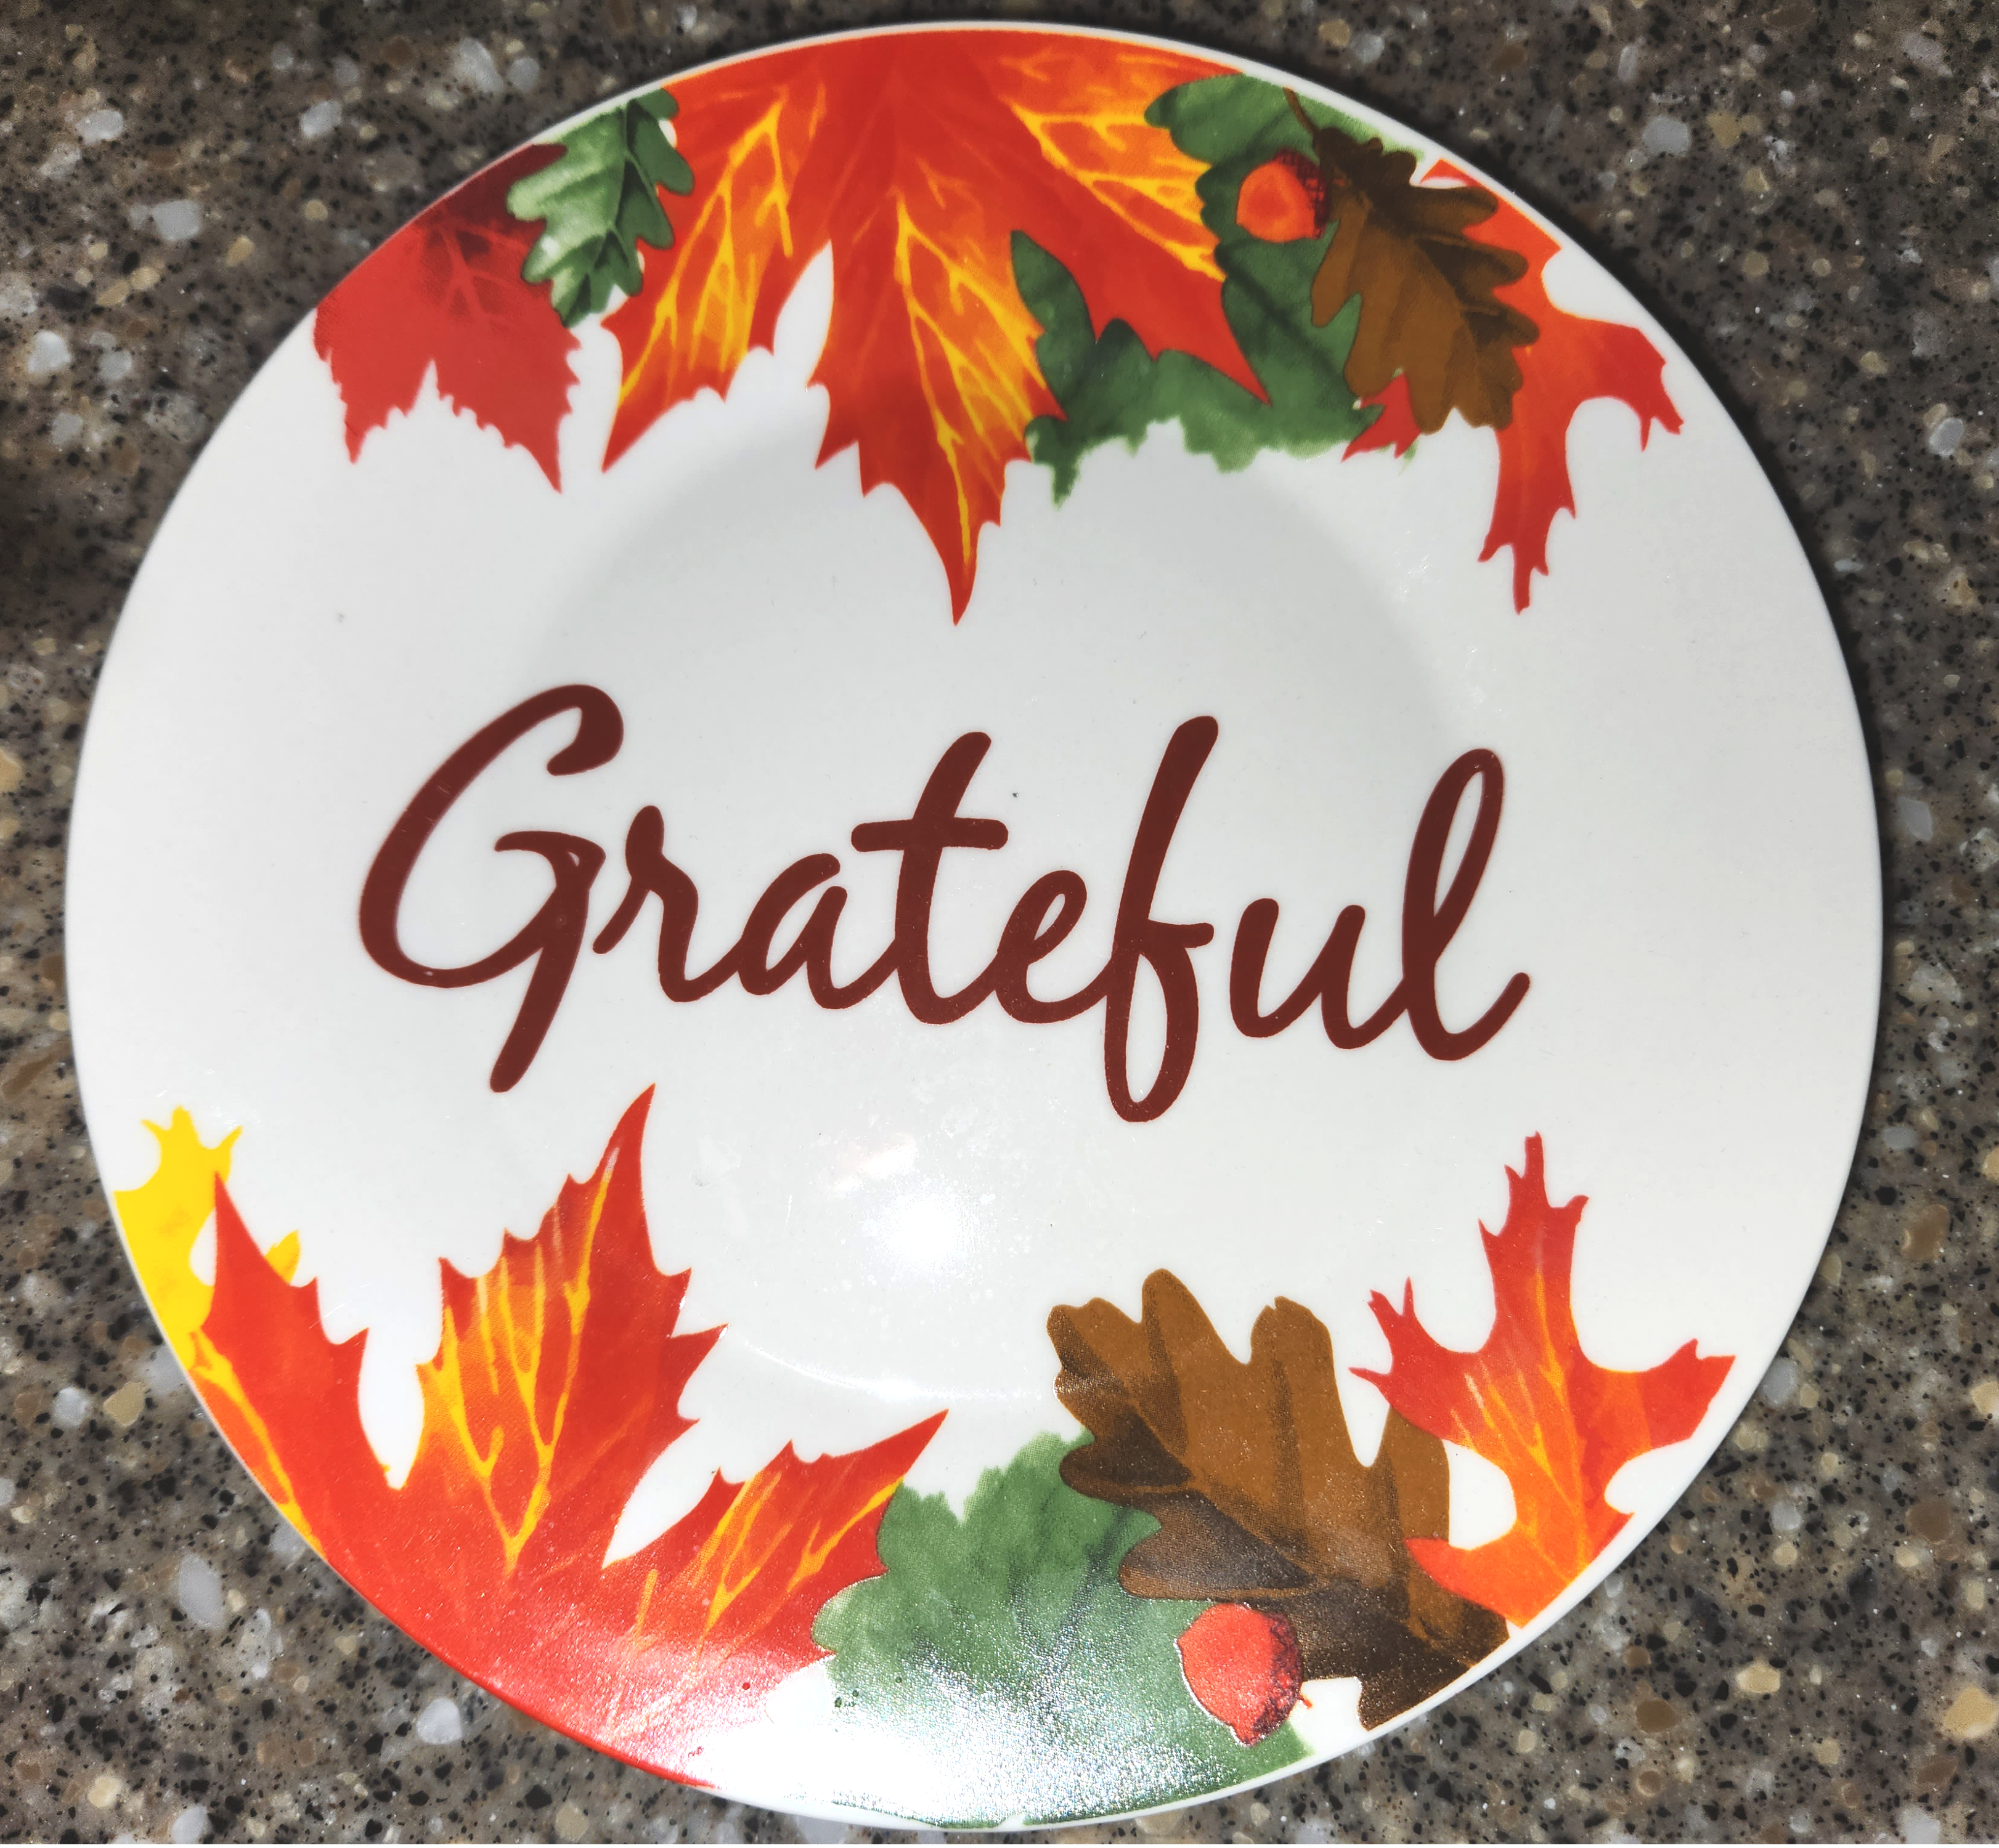
INTRODUCTION
Study of Colossians 1:11b-14
THANKSGIVING

Slide 2
CONTEXT
2nd sentence in letter: 1:9-20.
1:11b-14 is a participial phrase.
The participle
εὐχαριστοῦντες
is fourth marker of a worthy walk.

Slide 3
Grammatical Structure
Block Diagram:
with joy
Giving thanks to the Father
/-----------------------------|
Who qualified you…
Who rescued us…
Who placed us…
In whom we have redemption

Slide 4
I. Giving Thanks: Manner (vv. 11b-12a)
With Joy
Μετὰ χαρᾶς
Pattern of living
εὐχαριστοῦντες

Slide 5
II. Giving Thanks: to whom (vv. 12b-14)
A. He qualified you.
B. He rescued us.
C. He transferred us.
D. In His Son we have redemption.

Slide 6
CONCLUSION
Summary of Teaching:
Importance to us:
Lingering question:

